Slide 1
Pipelined Architecture for Multi-String Matching
Author: Derek Pao, Wei Lin, and Bin Liu
Presenter: Yi-Hsien Wu
Conference: IEEE Computer Architecture Letters
Date: 2017/6/7
Department of Computer Science and Information Engineering
National Cheng Kung University, Taiwan R.O.C.
Notes:
1

Slide 2
Outline
Introduction
Background
Pipelined Architecture
Performance Evaluation
Conclusion

Slide 3
Introduction
Many of the proposed hardware solutions are based on the well-known Aho-Corasick (AC) algorithm , where the system is modeled as a deterministic finite automaton (DFA).
The AC algorithm solves the string matching problem in time linearly proportional to the length of the input stream.
However, the memory requirement is prohibitive in a straightforward hardware implementation.
In this letter, we present a pipelined processing approach to the implementation
of AC algorithm, called P-AC.
The control logic of P-AC is simple and elegant. The memory cost is less than
30% of the best known AC-based methods.
Notes:
When the controller is responsible for all the tasks it becomes a bottleneck and the solution does not scale well. (reason 2)

Slide 4
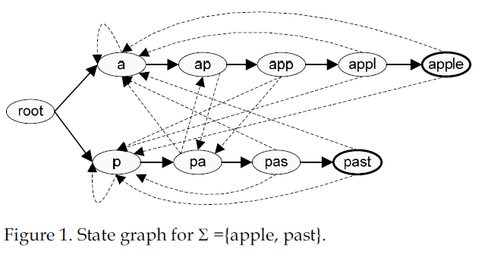
Background
An entry in the transition rule table is a 3-tuple E=(u=current state, i=input symbol, v=next state).
A match result is generated when the system reaches an output state.
Black line : forward edge ; Dashed line : cross edge ;
Notes:
When the controller is responsible for all the tasks it becomes a bottleneck and the solution does not scale well. (reason 2)

Slide 5
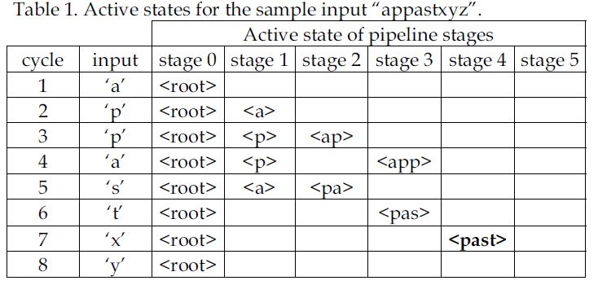
Pipelined Architecture
Suppose the input stream is “appastxyz” .
In the proposed pipelined architecture, a new thread is initiated to trace along the automaton starting from the current input character in each cycle.
By doing so, the system only needs to store the forward edges in the transition rule table.
Notes:
The OpenSec framework :
Security functions are provided by the processing units;
traffic is routed to each processing unit based on requiremens given through security policies;
the reaction to security alerts is automated.

Slide 6
Pipelined Architecture
Processing of Long Signatures :
In general, signatures can be longer than the hardware pipeline.
Assume the pipeline has k+1 stages numbered from 0 to k, where the last stage is only used to buffer the search result of stage k-1.
Strings longer than k characters are divided into segments of length k, except for
the last segment whose length can be less than k.
Notes:
Docker Community Edition (CE) is ideal for developers and small teams looking to get started with Docker and experimenting with container-based apps.
Docker 專案的目標是實作輕量級的作業系統虛擬化解決方案

Slide 7
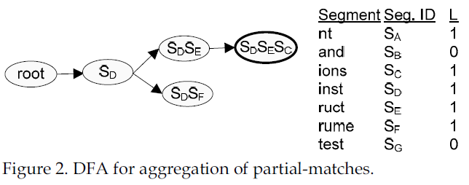
Pipelined Architecture
Consider a signature set with 4 strings = {and, test, instructions, instrument}.
Assume k is equal to 4, there are 7 segmented strings {nt, and, ions, inst, ruct, rume, test}.
Each segment is assigned a unique segment ID and a Boolean flag L( is
equal to 1 if the segment is part of a long string) .
Notes:
Docker Community Edition (CE) is ideal for developers and small teams looking to get started with Docker and experimenting with container-based apps.
Docker 專案的目標是實作輕量級的作業系統虛擬化解決方案

Slide 8
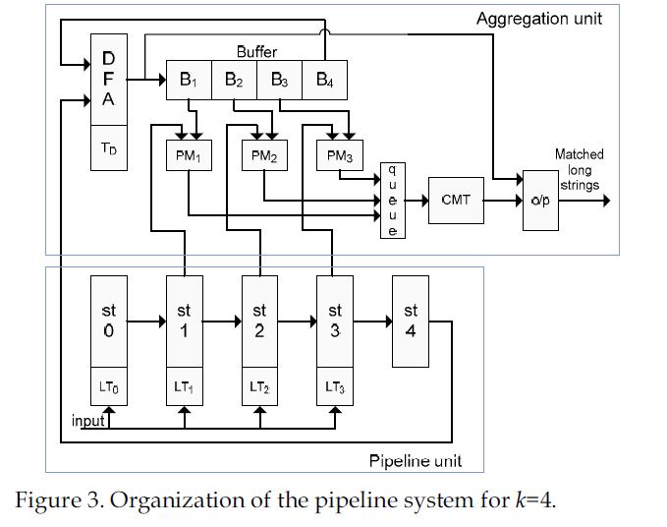
Pipelined Architecture
Let’s consider an example with the input stream equals to
“test instrument …” .
Notes:
Docker Community Edition (CE) is ideal for developers and small teams looking to get started with Docker and experimenting with container-based apps.
Docker 專案的目標是實作輕量級的作業系統虛擬化解決方案

Slide 9
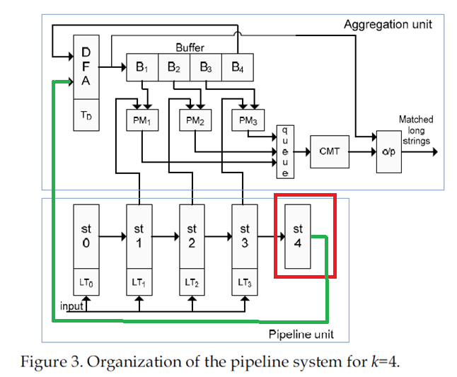
Pipelined Architecture
In cycle 5 the last stage of the pipeline detects the string “test”.
Notes:
Docker Community Edition (CE) is ideal for developers and small teams looking to get started with Docker and experimenting with container-based apps.
Docker 專案的目標是實作輕量級的作業系統虛擬化解決方案

Slide 10
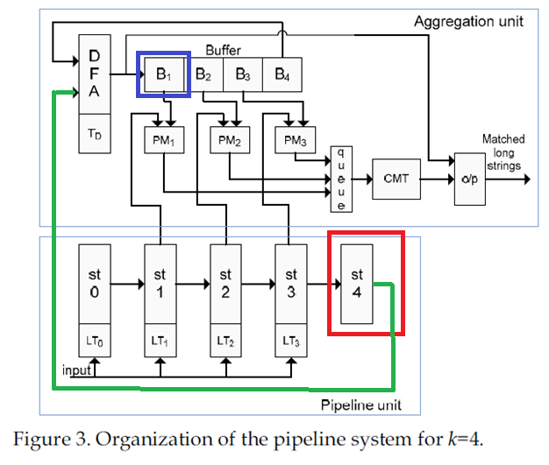
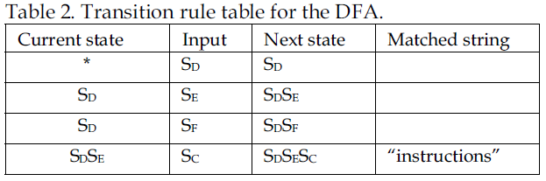
Pipelined Architecture
<SD>
In cycle 10, the pipeline unit detects the segment “inst” and passes its segment ID <SD> to the AU.
The state value <SD> will then be shifted into B1 at the start of the next cycle.
<SD>
Notes:
Docker Community Edition (CE) is ideal for developers and small teams looking to get started with Docker and experimenting with container-based apps.
Docker 專案的目標是實作輕量級的作業系統虛擬化解決方案

Slide 11
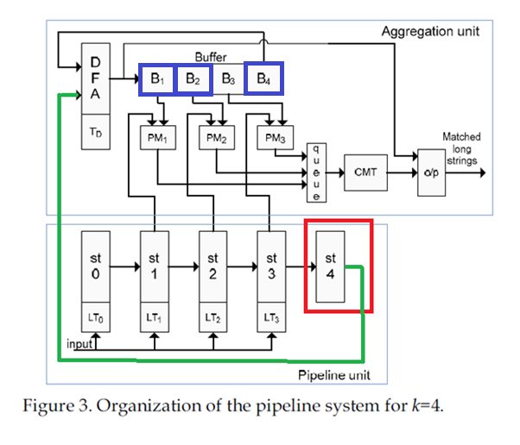
Pipelined Architecture
<SF>
<SDSF>
<SD>
In cycle 14, the pipeline detects the segment “rume”and sends the segment ID <SF> to the AU. At this moment, the state value <SD> would have been shifted down to buffer slot B4.
The DFA unit looks up table TD using the state value <SD> and the segment ID <SF> to find the next state <SDSF>.
<SF>
Notes:
Docker Community Edition (CE) is ideal for developers and small teams looking to get started with Docker and experimenting with container-based apps.
Docker 專案的目標是實作輕量級的作業系統虛擬化解決方案

Slide 12
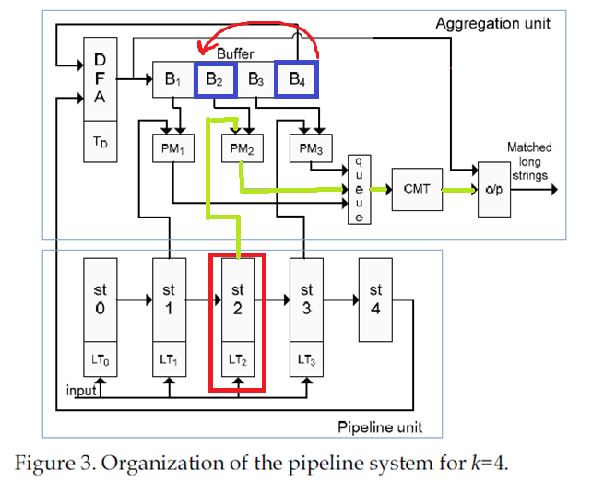
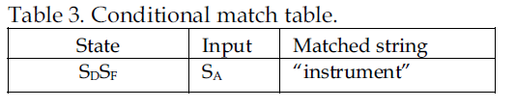
Pipelined Architecture
<SDSF>
In cycle 16, the segment “nt” is detected at stage 2 of the pipeline unit. At this moment, the state value <SDSF> is stored in buffer slot B2.
On receiving the segment ID <SA> for “nt”, PM2 sends a lookup request
to the CMT and finds the matched string “instrument” .
<SA>
Notes:
Docker Community Edition (CE) is ideal for developers and small teams looking to get started with Docker and experimenting with container-based apps.
Docker 專案的目標是實作輕量級的作業系統虛擬化解決方案

Slide 13
Pipelined Architecture
In principle the pipeline unit may find a matched segment in each stage at each cycle.
As a result, concurrent access to the CMT may be required. When there are multiple access requests, the requests are queued and served in FIFO
order.
Notes:
Docker Community Edition (CE) is ideal for developers and small teams looking to get started with Docker and experimenting with container-based apps.
Docker 專案的目標是實作輕量級的作業系統虛擬化解決方案

Slide 14
Performance Evaluation
We extract 4434 distinct signatures from the Snort rule set .
The signatures are converted into lower case letters.
The average signature length is about 19 characters, and the total character count is 84015. About 98% of the signatures have no more than 64 characters.
Our evaluation indicates that better memory efficiency is obtained when the segment length is in the range of 4 to 6.
For k=4, the number of entries in the lookup tables for the pipeline unit, the DFA unit, and CMT are 22031, 19289, and 3076, respectively.
The width of the state ID for the pipeline unit and the DFA unit are 15 bits and 14 bits, respectively.
The amount of memory space occupied by the entries of the lookup tables is 220KB.

Slide 15
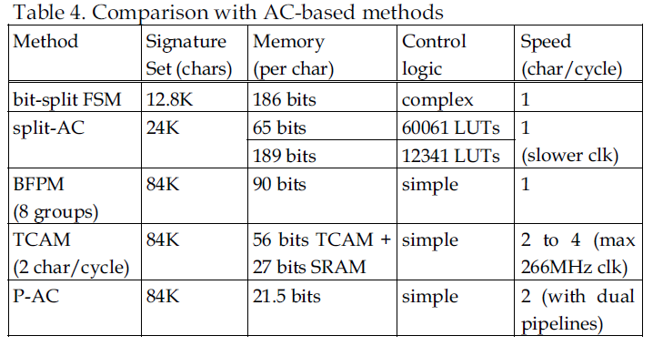
Performance Evaluation

Slide 16
Conclusion
A pipelined approach for hardware implementation of the Aho-Corasick algorithm called P-AC is presented.
The system maintains multiple threads that traverse the automaton concurrently. Only forward edges of the state graph need to be stored in the lookup tables.
In contrast to previously published heuristic-based methods, edge reduction in P-AC is guaranteed algorithmically.
This is an advantage that ensures scalability of the method in handling fast expanding signature sets of network intrusion detection systems.
For a signature set with 4434 strings extracted from Snort, the memory cost of P-AC is as low as 21.5 bits/char, which is less than 30% of the best known AC-based methods.
Simplicity and elegance of the pipeline control allows the system to operate at high clock rate.

